Slide 1
Correlation of Geomagnetic Storms with Infrasound Observation Data from International Monitoring System Stations Located in South America
Arthur S. de Macêdo, Elder Yokoyama, Lucas V. Barros, Darlan P. Fontenele e Juraci M. de Carvalho
University of Brasília
Place your institution logo here
(remove this text box)
REPLACE THIS TEXT
With your
Short Introduction
DO NOT CHANGE or RESIZE the Text or the Textbox
REPLACE THIS TEXT
With your
Methods/Data
DO NOT CHANGE or RESIZE the Text or the Textbox
REPLACE THIS TEXT
With your
Results
DO NOT CHANGE or RESIZE the Text or the Textbox
REPLACE THIS TEXT
With your
Conclusions
DO NOT CHANGE or RESIZE the Text or the Textbox
Please do not use this space, a QR code will be automatically overlayed
Px.x-xxx

Slide 2
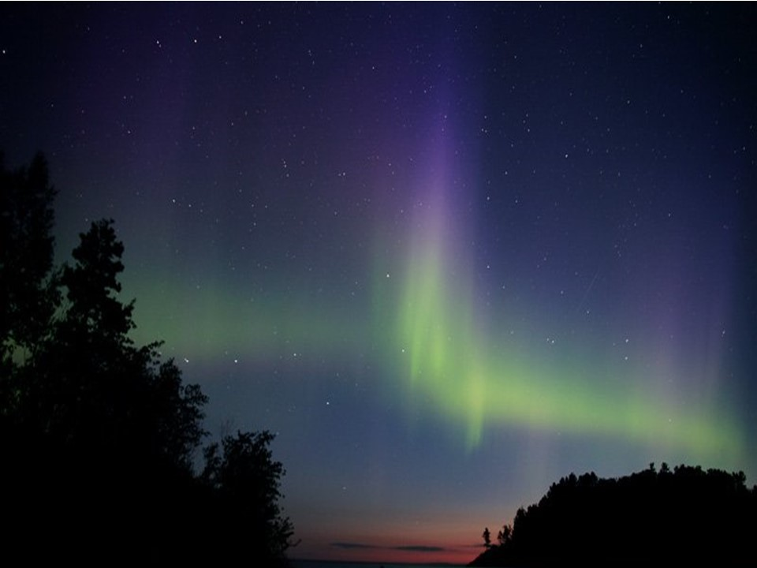
INTRODUCTION
Place your institution logo here after removing this text box!
The Earth is sporadically bombarded by solar storms, and its magnetic field acts as a protective shield, deflecting the radiation (Dal Poz, 2006).
It is known that ions propagated by these storms enter in polar regions, and they are responsible for the generation of auroras (Fig. 1), as follows:
(i) the aurora borealis, formed in the northern hemisphere; and
(ii) the aurora australis, formed in the southern hemisphere.
The movement of these ions in the atmosphere generates bow waves (Marty, 2019), which can be detected and recorded by acoustic sensors.
Please do not use this space, a QR code will be automatically overlayed
Fig. 1 – Auroral Phenomena (NOAA, 2023)
Px.x-xxx

Slide 3
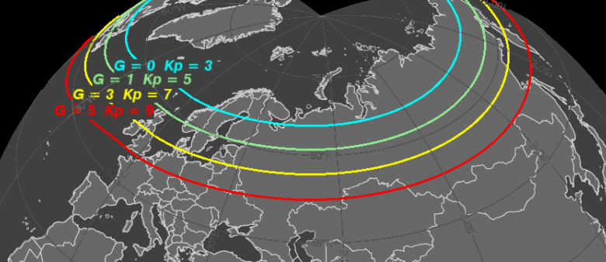
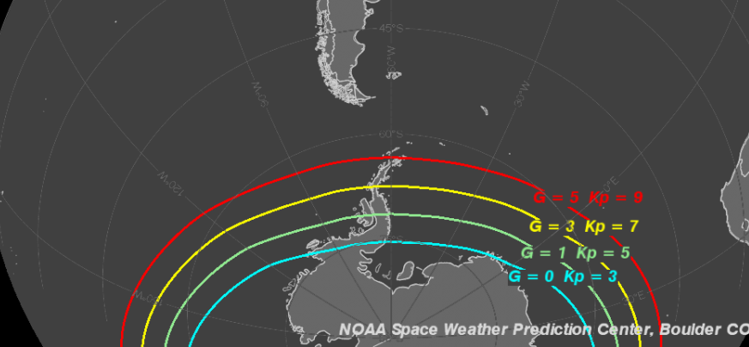
OBJECTIVES
Place your institution logo here after removing this text box!
This study aim is to correlate the occurrence of Auroras (Fig. 2) with signals detected at infrasound stations in South America.
According to Le Pichon et al., (2010) and Marty (2019) this space weather phenomena can be recorded by infrasound stations, including the International Monitoring System for Nuclear Test Ban stations (IMS-CTBTO).
This phenomena was studied by Wilson (2005) in northen IMS stations.
Please do not use this space, a QR code will be automatically overlayed
Fig. 2 - Map displaying the widest range of aurora observations based on the Kp indices of geomagnetic storms (NOAA, 2023).
Px.x-xxx

Slide 4
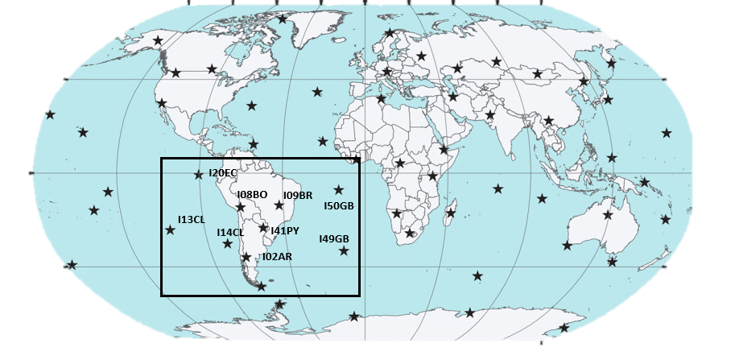
METHODS/DATA
Place your institution logo here after removing this text box!
The solar storm that occurred on April 23, 2023, was selected based on its Kp (PLANETARY K-INDEX) indice. The data was provided by ISIG (http://isgi.unistra.fr).
In order to provide good coverage of the region comprising South America, ten infrasound stations from the IMS were selected (Fig. 3).
Additionally, three stations in the northern hemisphere (I37NO, I42PT and I56US) were chosen for the purpose of comparing the temporal series.
I58US
I37NO
I42PT
Please do not use this space, a QR code will be automatically overlayed
Fig. 3 – IMS infrasound stations, in the boxes the stations used in this study (Adapted from Neri, 2019)
Px.x-xxx

Slide 5
RESULTS
Place your institution logo here after removing this text box!
Acho que podemos decidir o que colocar nesse slide amanha em reunião
Please do not use this space, a QR code will be automatically overlayed
Px.x-xxx

Slide 6
CONCLUSIONS
Place your institution logo here after removing this text box!
It is noticeable that the number of detections of signals generated by geomagnetic storms increases proportionally with the number of sensors and the proximity to the Aurora occurrence.
Since geomagnetic storms are known signals of infrasound in polar regions due to the Aurora effect.
Acho que cabe uma imagem aqui
Please do not use this space, a QR code will be automatically overlayed
Px.x-xxx

Slide 7
REFERENCES
Place your institution logo here after removing this text box!
A. Le Pichon et al. (eds.), Infrasound Monitoring for Atmospheric Studies, DOI 10.1007/978-1-4020-9508-5_6, © Springer Science+Business Media B.V. 2010.
Dal Poz, William Rodrigo; De Oliveira Camargo, Paulo. Conseqüências de uma tempestade geomagnética no posicionamento relativo com receptores GPS de simples freqüência. Boletim de Ciências Geodésicas, v. 12, n. 2, p. 275-294, 2006.
NERI, Brandow Lee. DETECÇÃO E INTERPRETAÇÃO DE SINAIS DE INFRASSOM COM A ESTAÇÃO INFRASSÔNICA DE BRASÍLIA – I09BR. 2019. (Graduação em Geofísica) - Universidade de Brasília, [S. l.], 2019.
WILSON, Charles R.; OLSON, John V.; STENBAEK‐NIELSEN, Hans C. High trace‐velocity infrasound from pulsating auroras at Fairbanks, Alaska. Geophysical research letters, v. 32, n. 14, 2005.
Please do not use this space, a QR code will be automatically overlayed
Px.x-xxx

